Slide 1

Ai generated vs real images classification
Author: Sidiropoulos Michalis
a Deep Learning Project

Slide 2

Agenda
Dataset
Baseline
CNN Architecture
Training
Evaluation
Conclusions

Slide 3
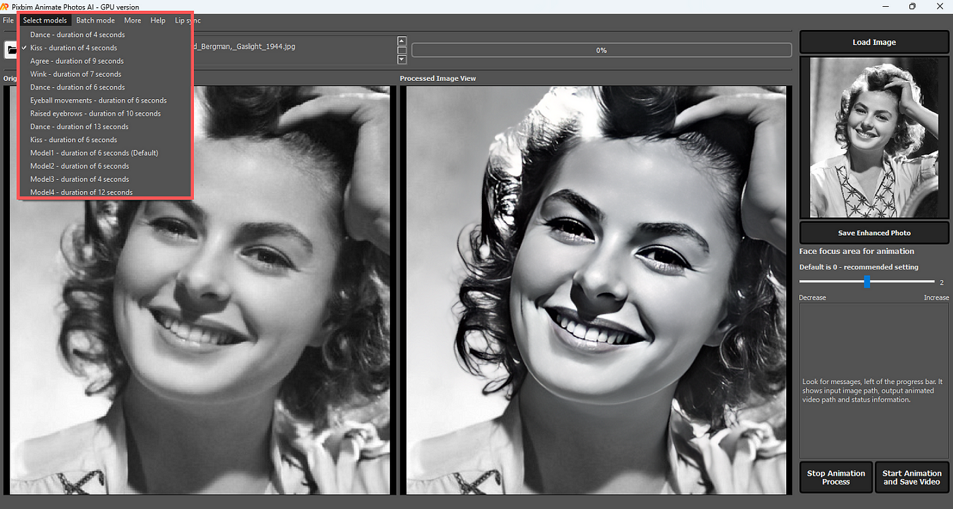
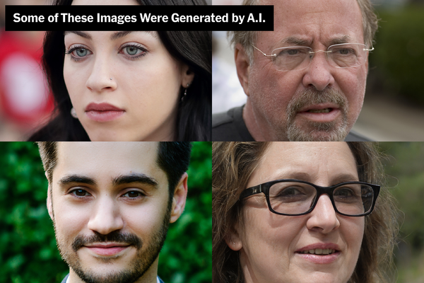


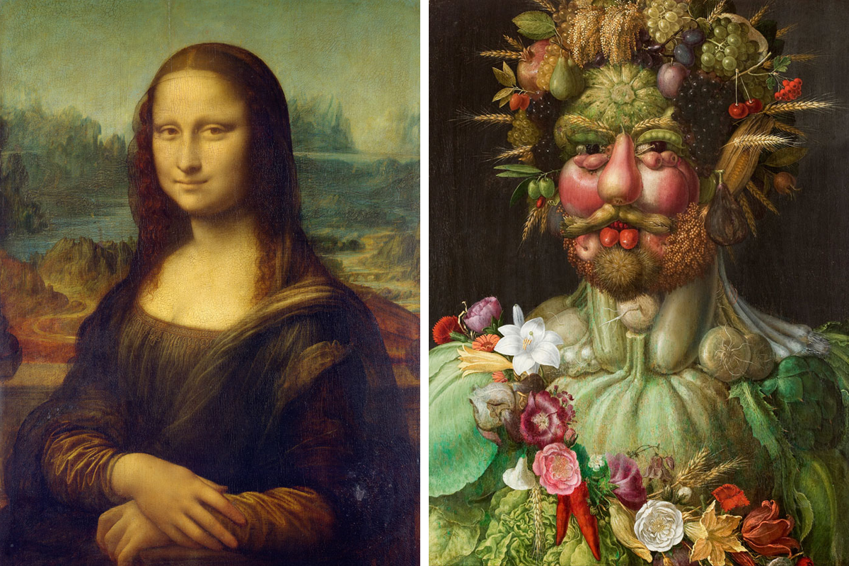
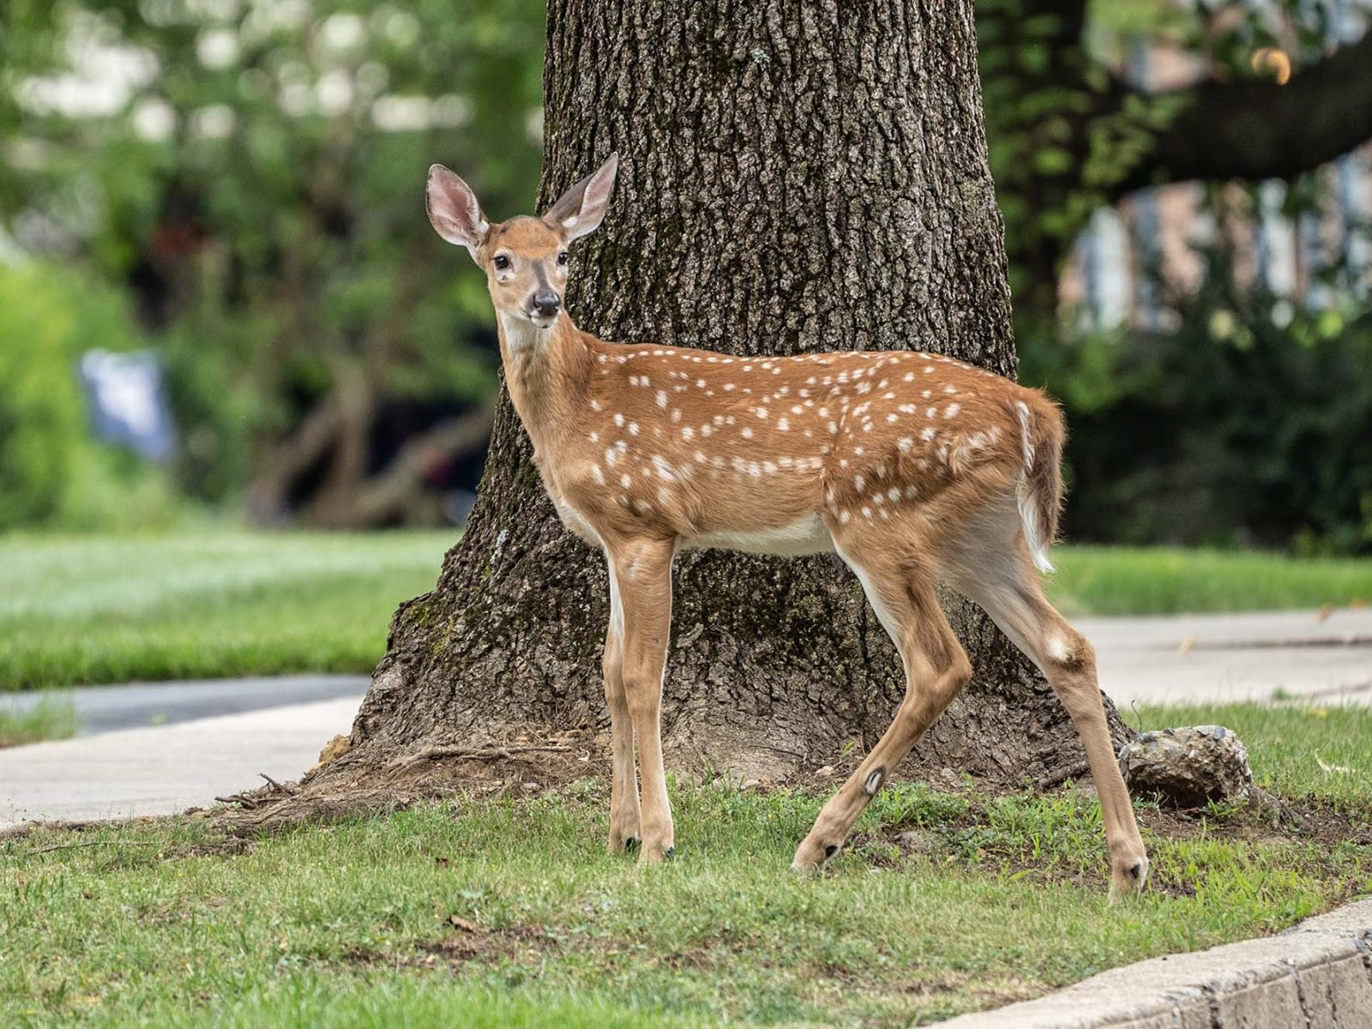



1. DataSET
AI Generated images = 539
Real Images = 436
Content :
People
Animals
Portraits
Scenery
Psychedelics

Slide 4

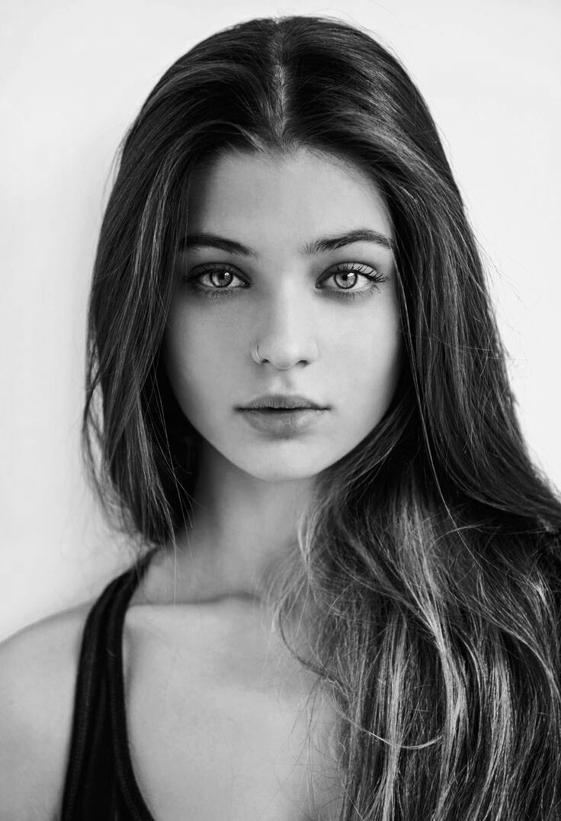




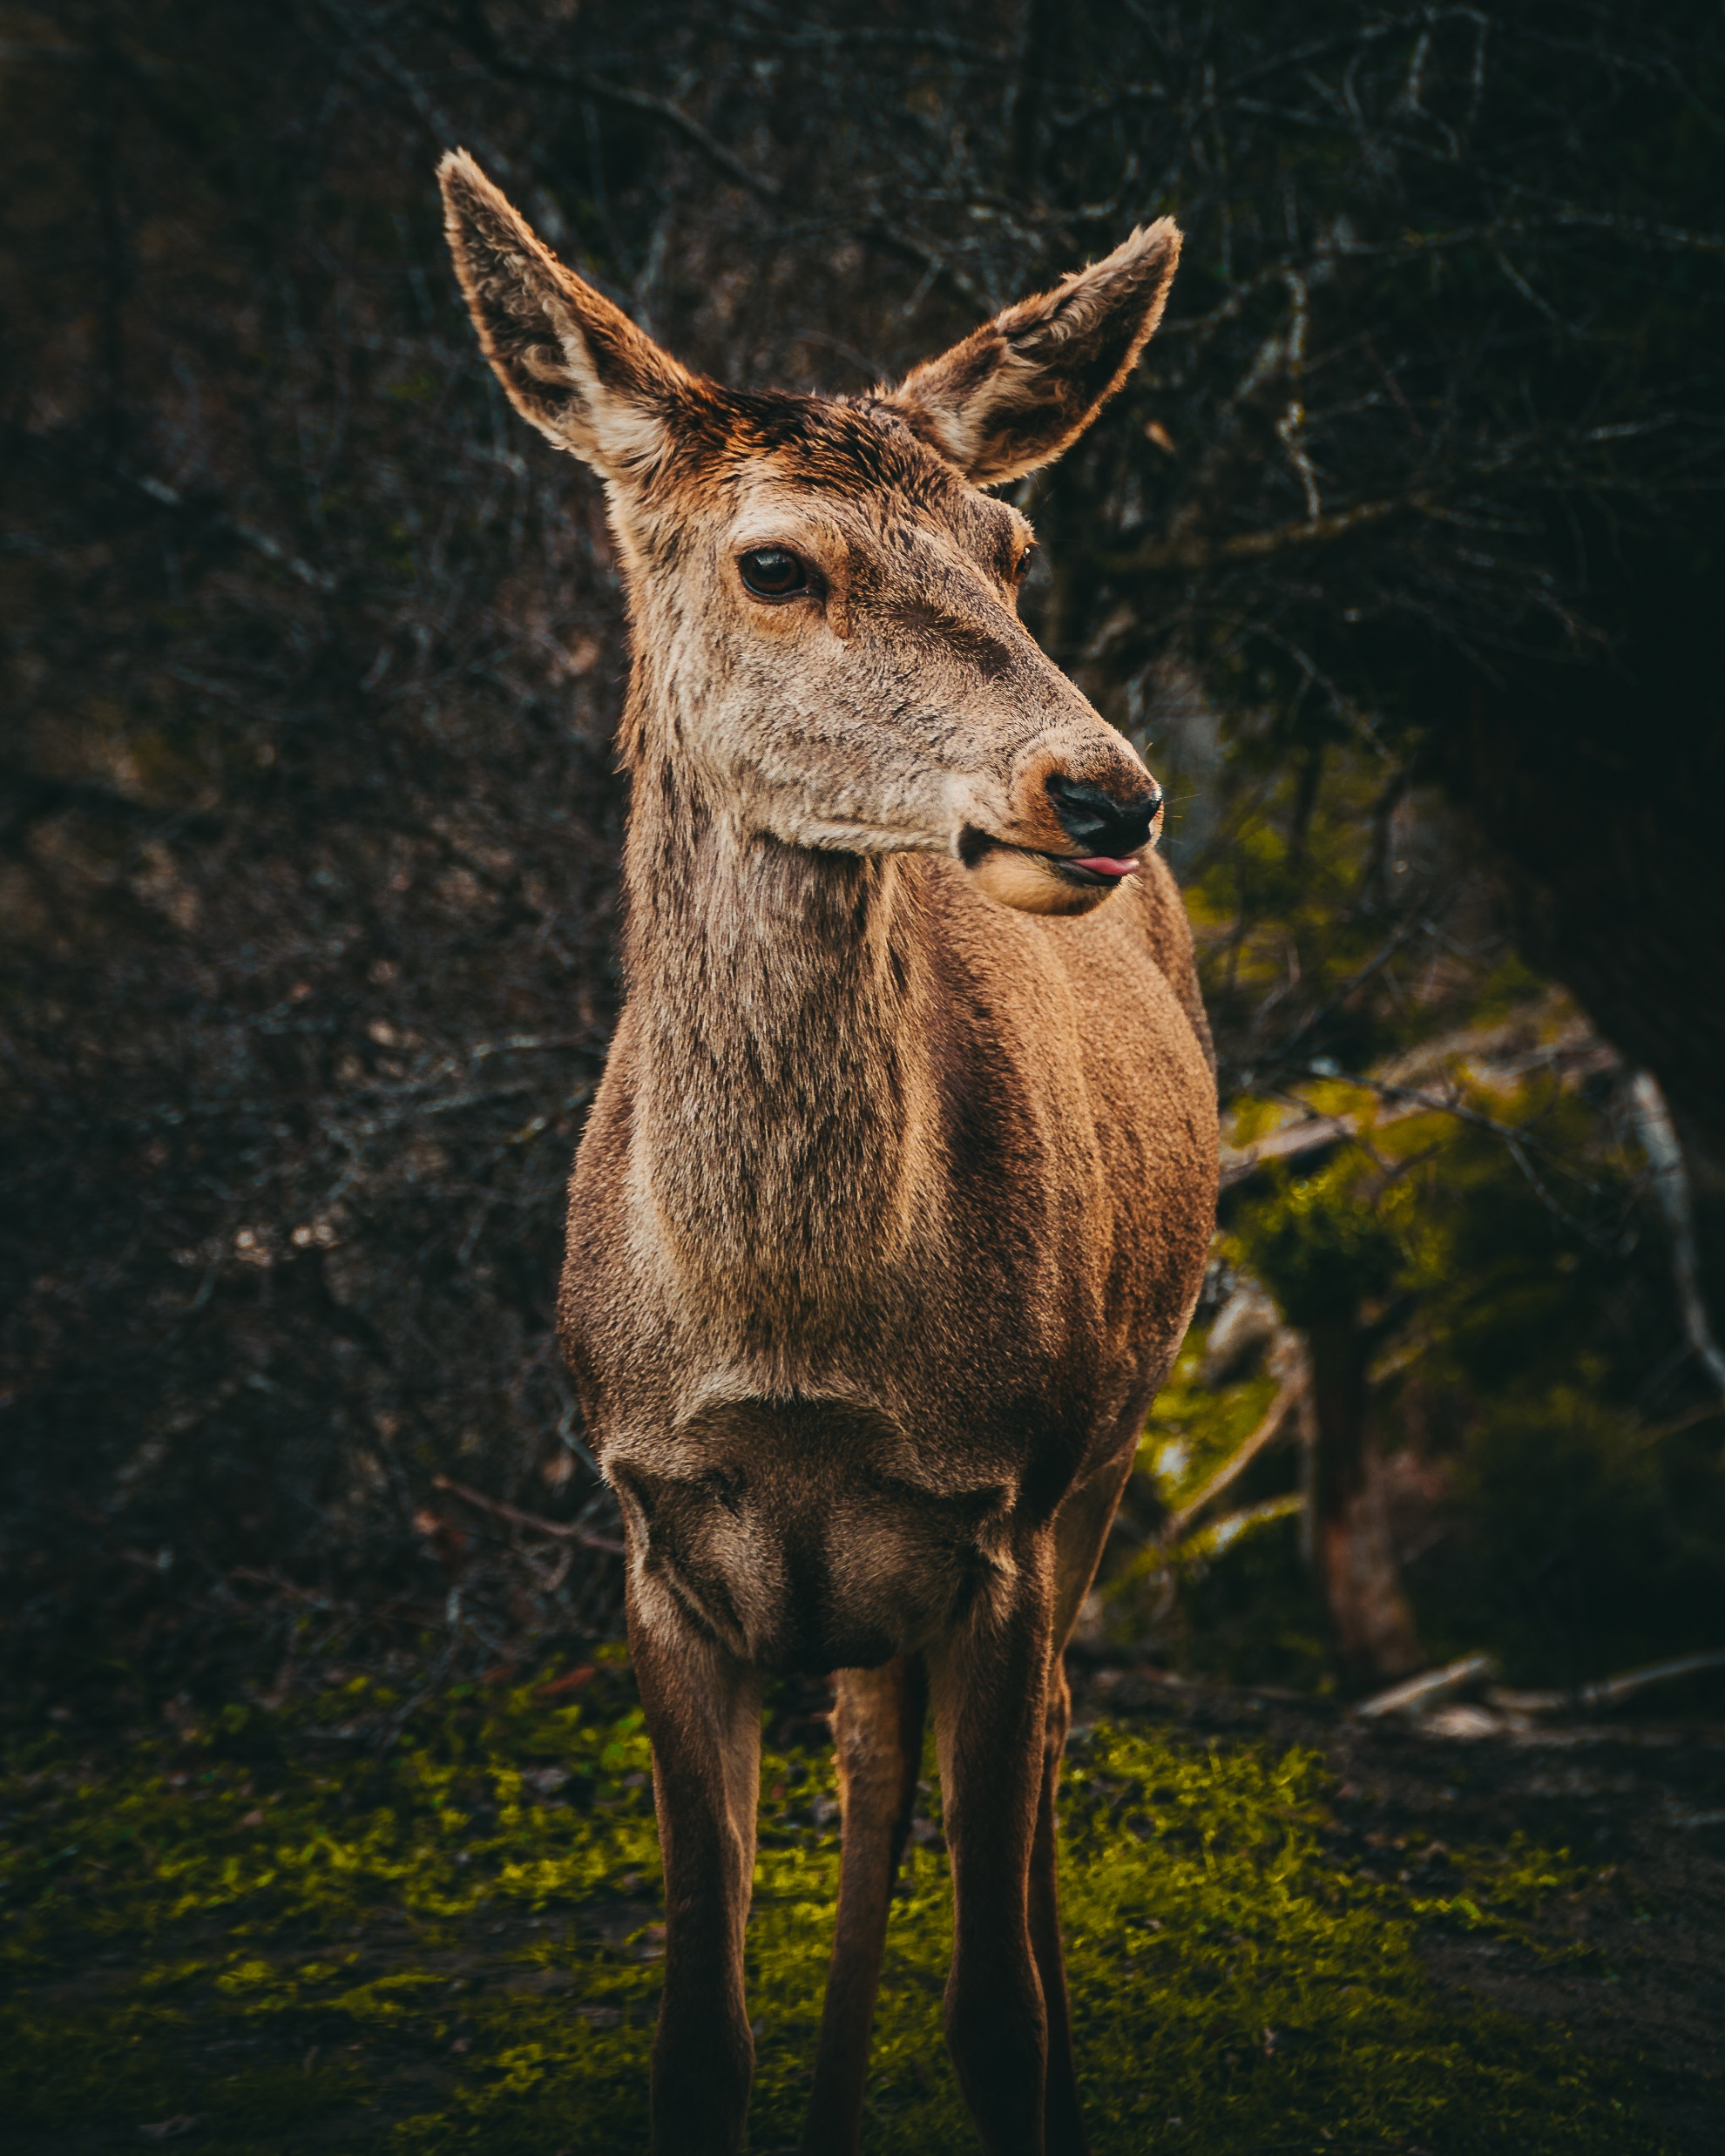


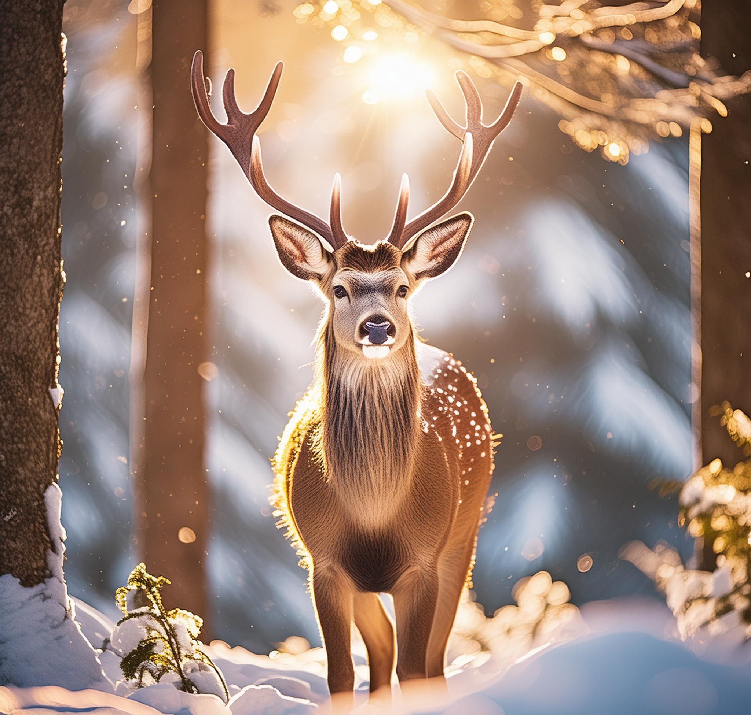




datasets
Training Dataset: 430 AI – 400 Real
Test Dataset: 30 AI – 30 Real
My Test Dataset: 35 AI – 35 Real
datasets
Augmentation: Crop, Vertical flip, Noise, Rotate
Feature Extraction: Resnet-18

Slide 5
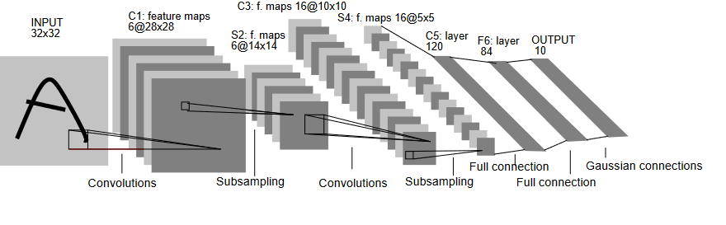
2. Baseline
Lenet – 5
Input channel RGB (3)
Pre – Trained Resnet
(removed last layer)
SVM
K-Folds
C = 1.7
Gamma = 0.002

Slide 6
2. CNN Architecture
Input channel RGB (3), input size 256x256
Convolutional Layer:
Kernel: 7x7, Stride: 1, Padding: 3
Batch Normalization
ReLU
Max Pooling: 2x2
Convolutional Layer:
Kernel: 5x5, Stride: 1, Padding: 2
Batch Normalization
ReLU
Convolutional Layer:
Kernel: 5x5, Stride: 1, Padding: 2
Batch Normalization
ReLU
Max Pooling: 2x2
5. Convolutional Layer:
Kernel: 3x3, Stride: 1, Padding: 1
Batch Normalization
ReLU
6. Convolutional Layer:
Kernel: 3x3, Stride: 1, Padding: 1
Batch Normalization
ReLU
Max Pooling: 2x2
7. Convolutional Layer:
Kernel: 1x1, Stride: 1, Padding: 0
Batch Normalization
ReLU
8. Convolutional Layer:
Kernel: 1x1, Stride: 1, Padding: 0
Batch Normalization
ReLU
9. Convolutional Layer:
Kernel: 1x1, Stride: 1, Padding: 0
Batch Normalization
ReLU
Max Pooling: 2x2
10. Fully Connected Layer:
Input: 16x16x1024
Output: 724
ReLU
Dropout: 0.5
11. Fully Connected Layer:
Input: 724
Output: 516
ReLU
Dropout: 0.5
12. Fully Connected Layer:
Input: 516
Output: 2

Slide 7
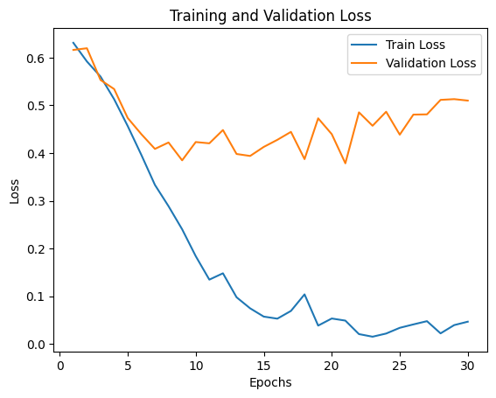
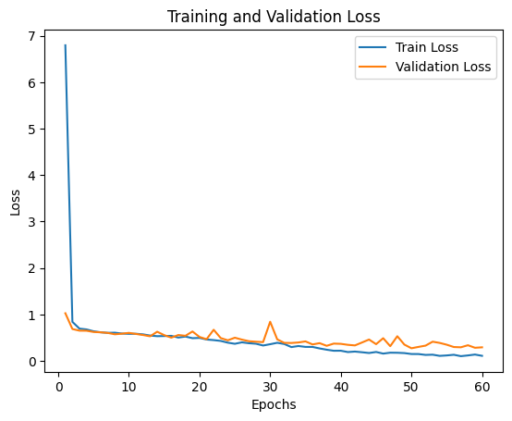
3. Training NNs
Lenet – 5
30 Epochs
32 Batch Size
Adam optimizer
Learning Rate 0.001
Cross Entropy Loss
CNN
64 Epochs
60 Batch Size
Adam optimizer
Learning Rate: 0.001
Cross Entropy Loss

Slide 8
4. Evaluation
Validation Metrics:
 | Lenet – 5 | CNN | SVM
Accuracy | 87.56 % | 89.76 % | 95 ± 0 %
Cross Entropy Loss | 0.51 | 0.294 | -
Precision | 87.6 % | 0.8976 | 0.94 ± 0.02
Recall | 87.5 % | 0.8974 | 0.95 ± 0.01
F1 score | 87.5 % | 0.8974 | 0.95 ± 0.0

Slide 9
4. Evaluation in Test Sets
Test set:
 | Lenet – 5 | CNN | SVM
Accuracy | 62 % | 72 % | 80 %
Precision | 0.62 | 0.72 | 0.85
Recall | 0.62 | 0.72 | 0.73
F1 score | 0.62 | 0.72 | 0.79
My Test set:
 | Lenet – 5 | CNN | SVM
Accuracy | 56 % | 50 | 54 %
Precision | 0.56 | 0.5 | 0.55
Recall | 0.56 | 0.5 | 0.46
F1 score | 0.55 | 0.5 | 0.50

Slide 10


